Slide 1
COMMONWEALTH OF AUSTRALIA
Copyright Regulations 1969
WARNING
This material has been reproduced and communicated to you by or on behalf of the SAE Institute Pty Ltd pursuant to Part VB of the Copyright Act 1968 (the Act).
The material in this communication may be subject to copyright under the Act. Any further reproduction or communication of this material by you may be the subject of copyright protection under the Act.
Do not remove this notice.

Slide 2
GPG 210
Introduction to
Unreal Engine
Week 01
Cliff Sharif
c.shariff@sae.edu
GPG 210 – Game Programming Studio 1

Slide 3

The Unreal Engine is a source-available game engine developed by Epic Games, first showcased in the 1998 first-person shooter game Unreal.

Slide 4
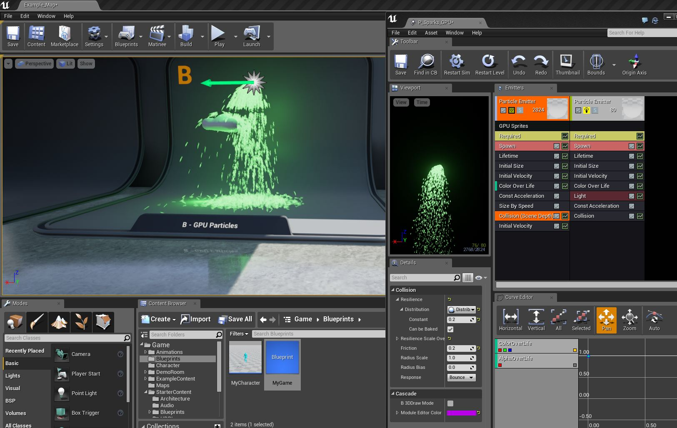
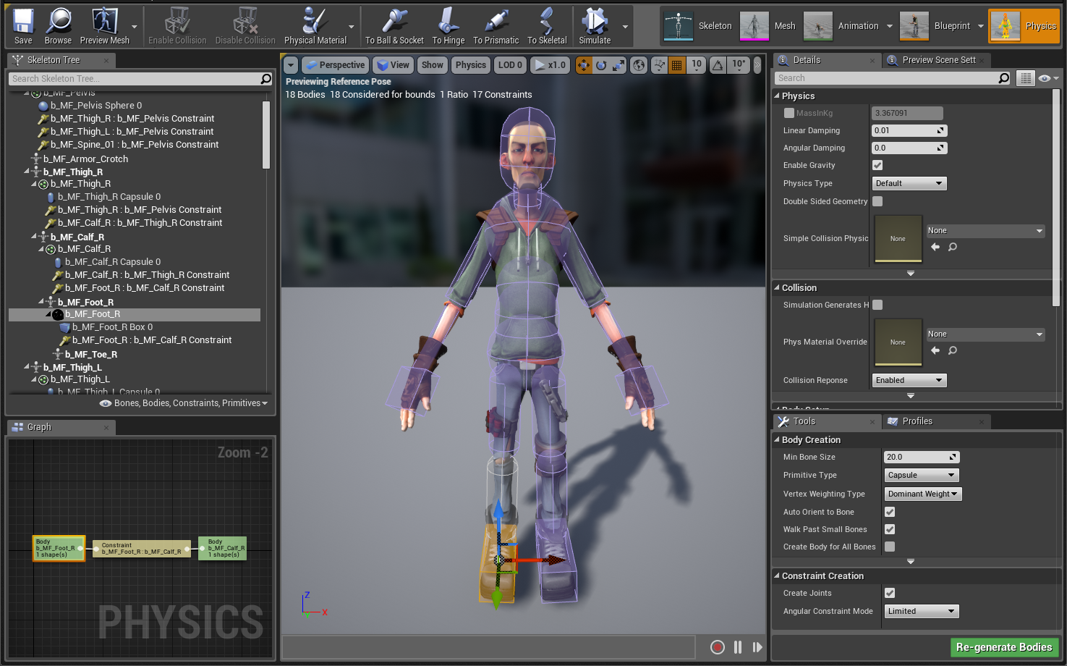
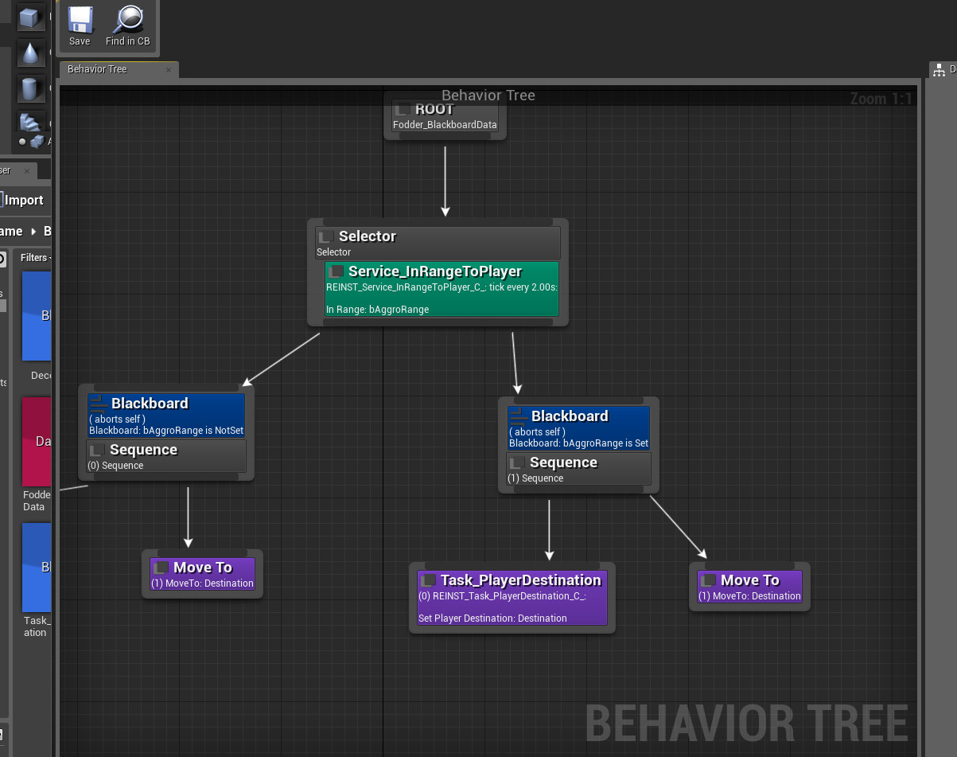
Level Editor
Material Editor
Blueprint Editor
Behaviour Tree Editor (AI)
Persona Editor
Cascade Editor (Particle Systems)
UMG UI Editor
Matinee Editor
Sound Cue Editor
Paper2D Sprite Editor
Paper2D Flipbook Editor
Physics Asset Tool Editor
Static Mesh Editor
Media Player Editor

Slide 5
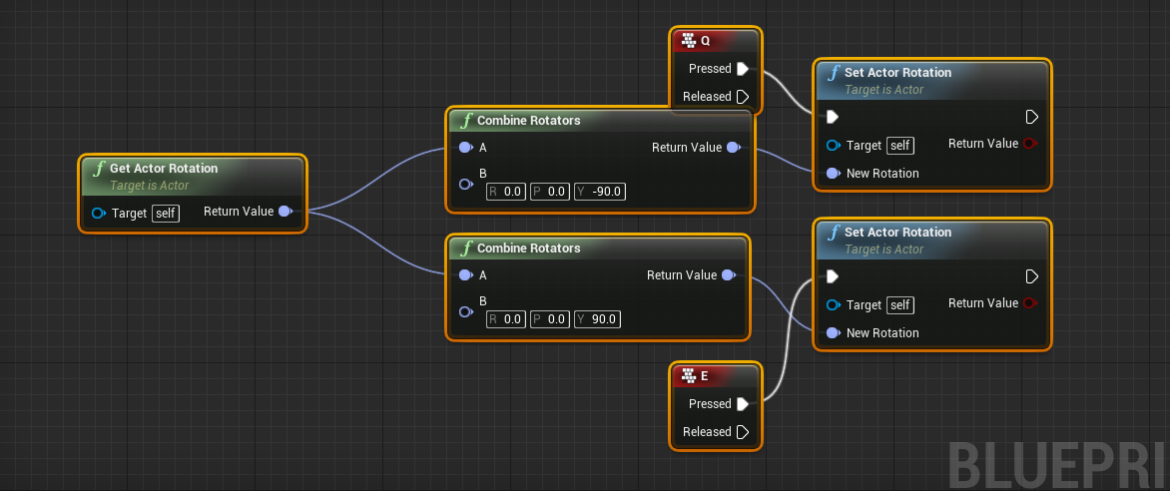
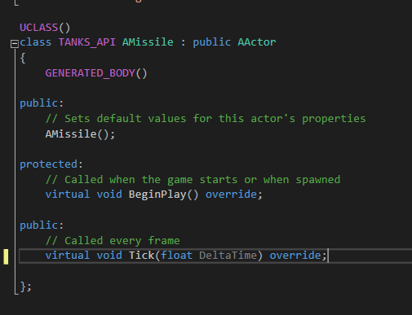
Unreal Engine provides two methods, C++ and Blueprints Visual Scripting, to create new gameplay elements.
The Blueprints Visual Scripting system in Unreal Engine is a complete gameplay scripting system based on the concept of using a node-based interface to create gameplay elements from within Unreal Editor.
Using C++, programmers add the base gameplay systems that designers can then build upon or with to create the custom gameplay for a level or the game.

Slide 6
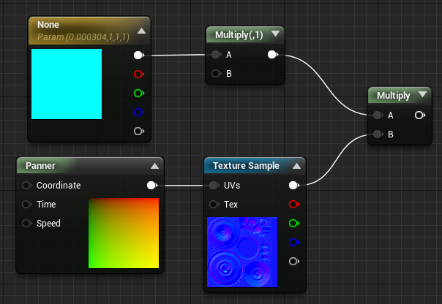
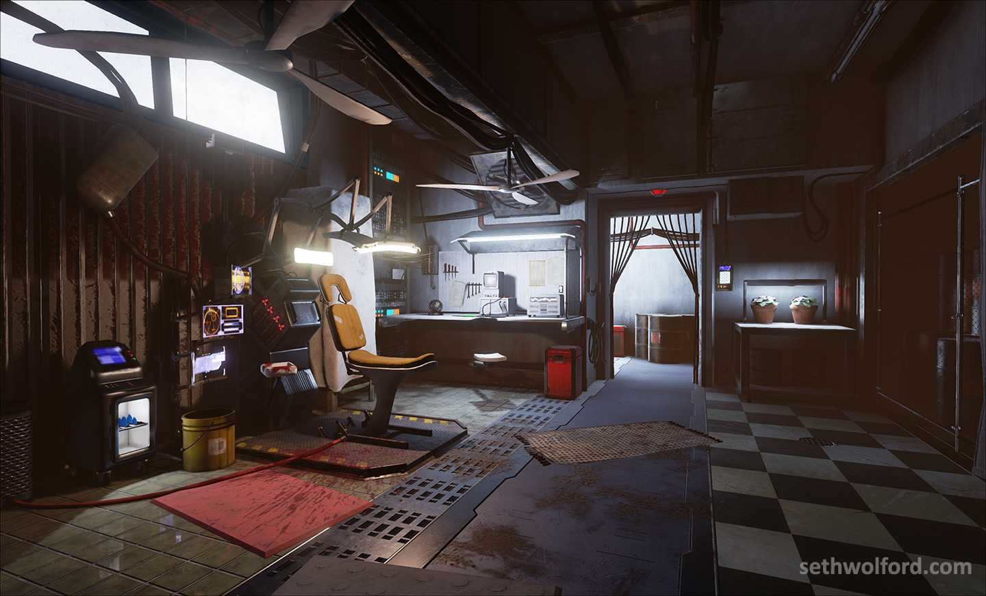
Material Editor
The Material Editor is a node-based graph interface that enables you to create shaders that can be applied to your geometry, such as Static and Skeletal Meshes, or with other systems such as Cascade to create interesting materials.

Slide 7
Unreal Engine Usage The latest one, September 2018 !
https://www.youtube.com/watch?v=BID7de_DhWQ
ArchVize VR https://www.youtube.com/watch?v=eTt7AGIpV2I&t=83s
Physics Simulation
https://www.youtube.com/watch?v=-S8wq0dz1H4
AI
https://www.youtube.com/watch?v=9SVC7XBhBpk

Slide 8
References:
Unreal Engine 4 Documentation
https://docs.unrealengine.com/en-us

Slide 9
Course module overview
GDS 210
https://moodle-sae-au.axis.navitas.com/pluginfile.php/563846/mod_resource/content/0/1_A_UG_GDS210GamesStudio1GamesDesign_160905.pdf
GPG210
https://moodle-sae-au.axis.navitas.com/pluginfile.php/564550/mod_resource/content/1/1_A_UG_GPG210GamesStudio1Programming_160905.pdf
Notes:
Run through course learning outcomes and assessments.

